Slide 1
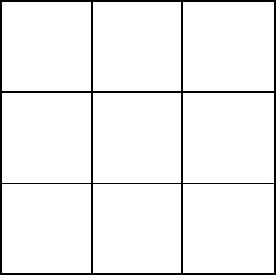
Player one
Player two
Choose colour from drop down
Choose colour from drop down
First page
Colour scheme – pastel and deep colours, high contrast. < this is a colour scheme chosen after conducting a survey of students in the class with their preferred colour schemes.
Players can enter their own names and choose, from a selection, of their light colour. Each player is given three lights, 1-3 is player one, crosses. 4-6 is given to player 2, nought's.
Index
Play
About

